Slide 1
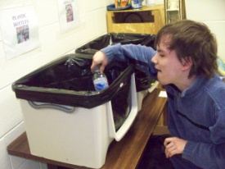
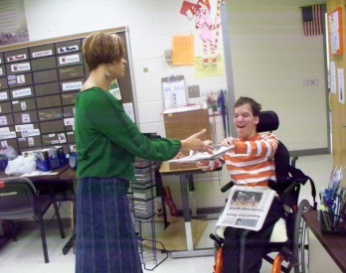
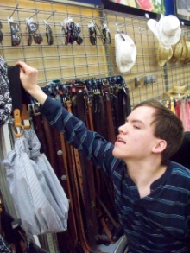
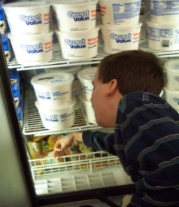
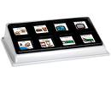
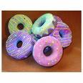
I Like To
Accommodations that Work
Verbal Praise
Recycling
Delivering the Paper
Augmentative
Communication System
Stocking at Wal-Mart
Shopping
Joe Marks
In the Future I Want To
Attend Homecoming
Parade
Attend Senior Breakfast
Graduate at the Siegel
Center
Attend Prom
Attend Senior Picnic

Slide 3
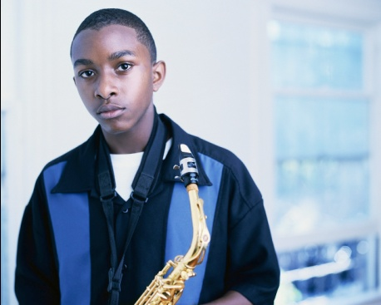
Hey I’m Robert. I’m 14 no I’m just joking. I’m really 12. Have great time reading this.
I have an IEP because … I have anger issues I need to control it and not get angry over little things and not get frustrated.
My Interests:
I like to play star wars games and draw
My hardest classes:
Math because division and multiplication have a lot of thinking
Social studies because all the writing and highlighting.
Ways to learn best:
Skip some problems and go to next one until I can get it.
Read the question first then read the story.
My favorite classes:
L.A because I love The word ladder
P.E because I like to play games
My plans for the future:
Go to Virginia Tech college.
Be a game designer .
Buy my own house.
Start a basic job before I be a game designer.

Slide 4
dfjkjfkjdlfjkldjfaljjlkkldjsfkjejeljelk
Joe

Slide 5
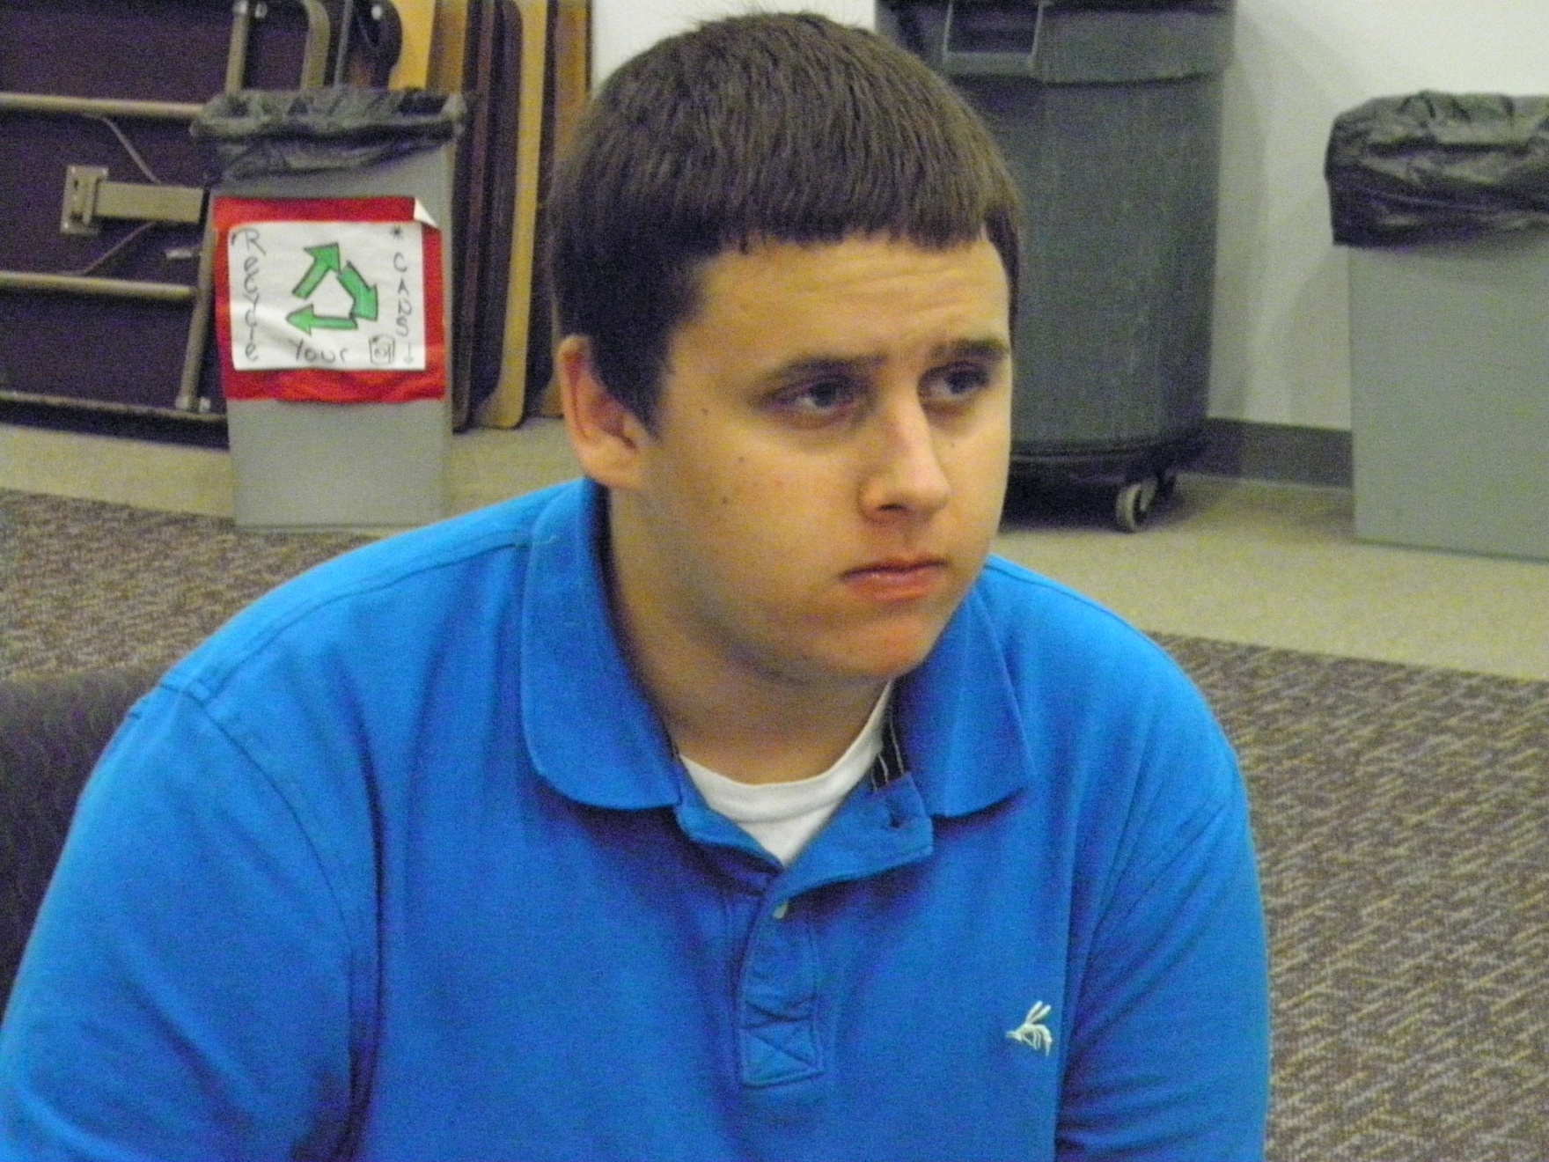
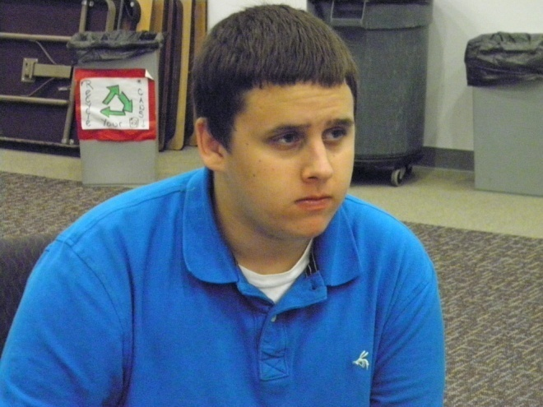
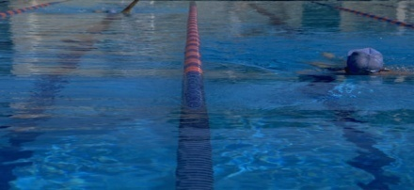
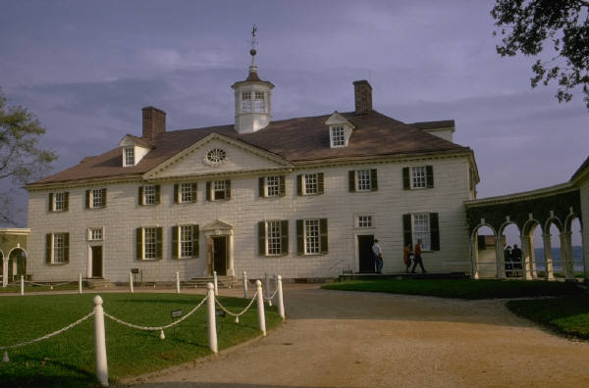
I Want You to Know
John
I often make the honor roll.
I am really good with my hands.
My sister and I were adopted at birth.
My favorite class is social studies.
My parents are both teachers.
I have severe migraines.
I was diagnosed with ADHD at age 4.
I have a learning disability.
I have difficulty putting my thoughts onto paper.
I am on the VDOE Youth Leadership Team.
I speak around the state on self-determination.
I scored a perfect score on my Geometry SOL.
Interests
Basketball
Softball
Video Games
Computer Games
Youth Groups
Special Olympics (Unified)
Learning Styles
Auditory/Kinesthetic
I want to live in a big house with a pool.
Accommodations that Work
Extended time on assignments
Scribe
10 problems in math per night
Water Breaks
Clinic Visits
Study Guides and Back-up Notes
My college choice is John Tyler.
My career interest is in
Criminal Justice.

Slide 6
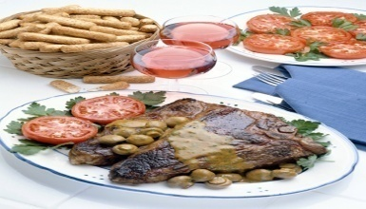
APTITUDES
Oral Expression
Calculator Usage
Clerical Perception
Good Use of Hand Tools
Motor coordination
Manual dexterity
Eye Hand Coordination
Bi-Manual Coordination
Color Discrimination
Shape/Size Discrimination
Finger Dexterity
Name
Address
DOB:
INTERESTS
Hair Care
Food Service
Meadowbrook High
WORK BEHAVIOR GOALS
LEARNING STYLES
Work Pace
Remain on Task
Work independently
Auditory Numerical
Social Individual
Auditory Language
Expressive Written
RECOMMENDATIONS
POSITIVE WORK BEHAVIORS
Attendance/Punctuality/Hygiene
Safety Awareness
Positive Attitude
Stamina
Follows Instructions
Cooperative Attitude
Supervisory Acceptance
Adheres to dress code
Career Counseling/Career Education
Community-Based Training
Career Exploration
Career Interest Academic Classes
Transition Services
Systematic Instruction
Self-advocacy training

